Slide 1
Introduction to Network Security
INFSCI 1075: Network Security
Amir Masoumzadeh

Slide 2
Survey Results
Count: 23
Other courses: 4
Individual vs. group labs: 0.44
TCP/IP: 6 / 10
Crypto: 1.5 / 10
Technical vs. general: 0.47
Office hours: Tue.-PM (9) vs. Wed.-PM(8)
  It remains as set before: Tue. 2pm-4pm
Term project: Yes(13) / Maybe (6)
  Paper vs. development: 0.41

Slide 3
Outline
What is network security? Why?
Benefits of good security practices
Approaches to network security
  Three Ds of security
  ITU-T X.800 Security Architecture for OSI
Attacks vs. threats
Security services
Security mechanisms

Slide 4
Information Security: Yesterday’s goal vs. Today’s
Information Security requirements have changed in the new digital economy
Traditionally provided by physical and administrative mechanisms
  Information was primarily on paper, lock and key, safe transmission
  Control access to materials, personnel screening, auditing
  Blocking access to majority is no longer valid!
Information Security today: enables businesses.
  Every company wants to open up its business operations to its customers, suppliers, and business partners! (e.g. Car manufactures)
  The more access you provide, the more people you can reach. (do more with less!)
So, how information security enables businesses?
  By automation of business processes, made trustworthy by appropriate security strategies and techniques!

Slide 5
Information Security Today
Deals with
  Security of (end) systems
    Examples: Operating systems, files in a host, records, databases, accounting information, logs, etc.
  Security of information in transit over a network (Network security)
    Examples: e-commerce transactions, online banking, confidential e-mails, file transfers, record transfers, authorization messages, etc.

Slide 6
What is Network Security?
Protection of networks and their services from unauthorized modification, destruction, or disclosure, and provision of assurance that the network performs its critical functions correctly and there are no harmful side-effects [INFOSEC-92]
  http://www.cultural.com/web/security/infosec.glossary.html

Slide 7
What is Network Security? (Cont.)
Focuses mainly on different networks, network protocols, and network applications
Includes all network devices and all applications/data utilizing a network (not just “computers”)
Includes “Application Layer” vulnerabilities
Includes Routers, Switches, Satellites, etc.
Includes cellular phones, PDA's, MP3 players, browser-enabled gadgets, etc.
Even network cards or other computer hardware

Slide 8
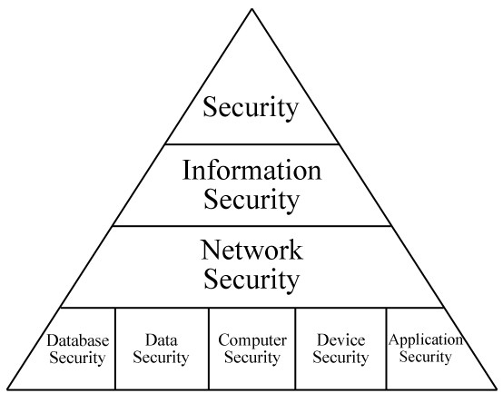
What is Network Security? (Cont.)
Security
  Protecting general assets
Information Security
  Protecting information and information resources
Network Security
  Protecting data, hardware, software on a computer network

Slide 9
What is Network Security? (Cont.)
Network security is increasingly integrated with other security sub-disciplines
  Exploits that exist within applications
  Exploits that exist within operating systems
  Viruses & Worms (What’s the difference?)
  Vulnerabilities originating from the user
    Weak passwords
    Unsafe user practices (file-sharing, IM, etc.)
    Social engineering?
      Getting employees to reveal sensitive information about a system
      Usually done by impersonating someone or by convincing people to believe you have permissions to obtain such information
      Or by incentives

Slide 10
What is Network Security? (Cont.)
Network security is not just about hacker attacks
  Data loss caused by mishandling, misuse, or mistakes
  Ensuring service availability
    E.g. Loss of service can take a very large bite out of a company’s stock price!
    Bad reputation!
  Protection from negligent internal sources (e.g. file sharing)

Slide 11
What is Network Security? (Cont.)
Today, network security is viewed as prevention AND as an enabling mechanism
    Reduce business costs/expenses
    Provide new opportunities for revenue
    Enable new, faster, and more productive business processes
    Provide competitive advantage
In some cases, documented security may be necessary to allow a business access to a certain market (e.g., Healthcare, Financial, etc.)

Slide 12
Why Network Security? (Past & Present)
Security began with two opposed models
    Academic - Everything is open
    Government/Military - Everything is closed
This changed as business and home users entered the world of networks and e-commerce
      Closed door is too restrictive, open allows for little or no protection
      Needed new model to provide limited/controlled access
Today, security is much more complex
    Enable valid users (at various levels) while keeping out intruders

Slide 13
Benefits of Good Security Practices
Looking at security only as an expense is a big mistake!
Business Agility
  Technology centered business models demand access to data and back-end services
    Information MUST flow (e.g. Car manufacturers again)
  Security allows an organization to selectively allow access to data
  This facilitates business processes
    Information sharing with peers and contractors
    Information analysis and assessment
  Control over information gives businesses a strategic advantage

Slide 14
Benefits of Good Security Practices (Cont.)
Return on Investment (ROI)
  What does security contribute to the company / individual?
  Two major components
    Risk Management (preventive aspect) – How much have we saved by avoiding attack?
      Accept Risk
      Mitigate Risk
      Transfer Risk
    Business Contributions (Enabling aspect) – What does security enable?
      How has security benefited our business processes?
      What doors has security opened for our company?

Slide 15
The Three Ds of Security
Defense (instinctive and always precedes others)
  Reduces likelihood of successful security compromises
  e.g., firewalls, ACLs, spam and virus filters, etc.
Deterrence (laws against violators)
  Reduces frequency of security compromises
  e.g., threats of discipline & termination for employees for violation of policies
Detection
  Without that a security breach may go unnoticed for hours, days, or even forever
  e.g., auditing and logging, IDS, etc.
All three must be applied!
Detection
Defense
Deterrence

Slide 16
ITU-T X.800: Security Architecture for OSI
Defines a systematic way of defining and providing security requirements
  For us it provides a useful, if abstract, overview of concepts we will study
Breaks security down into security services and mechanisms
  Services – generic constructs designed to provide system/data security at a particular level
  Mechanisms – specific methods used to realize the services necessary to provide adequate system/data protection
    A process that is designed to detect, prevent, or recover from attack

Slide 17
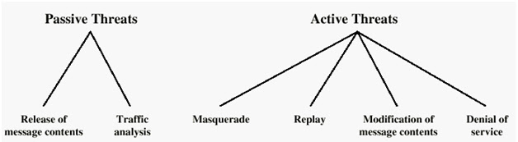
Attack vs. Threat
A threat is a “potential” violation of security
  The violation does not need to actually occur
  The fact that the violation might occur makes it a threat
  It is important to guard against threats and be prepared for the actual violation
The actual violation of security is called an attack
  Passive – attempts to learn or make use of information without affecting system resources
  Active – attempts to alter system resources and affect their operation

Slide 18
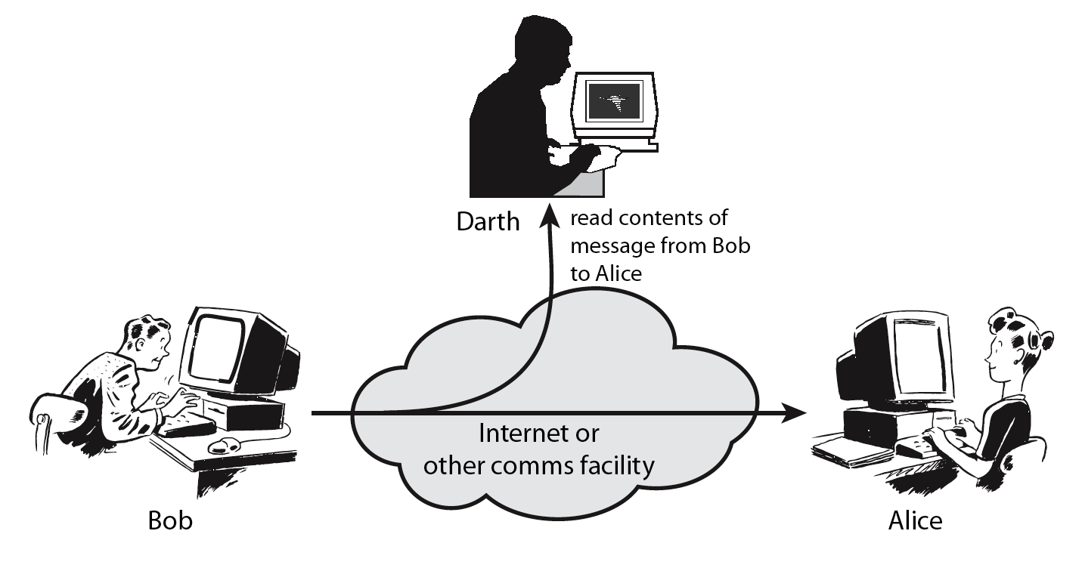
Passive Attacks

Slide 19
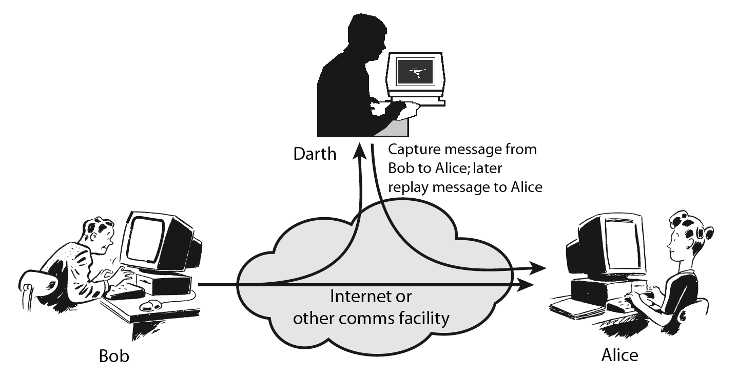
Active Attacks

Slide 20
Security Services
In general
  Measures intended to counter security attacks by employing security mechanisms
    Like physical procedures, but increasingly automated
    Examples - signatures, documents, ID cards, endorsements, etc.
Typical services that are considered are confidentiality (privacy), authentication, integrity, non-repudiation, availability

Slide 21
Security Services (X.800)
Authentication
  Makes sure that the communicating entities are the ones who they claim to be
Access Control
  Prevention of unauthorized use of a resource
Data Confidentiality
  The contents of a message/data are not disclosed to unintended parties
Data Integrity
  Messages/data are not modified in an unauthorized way
Non-Repudiation
  Protection against denial by one of the parties in a communication (sender/receiver cannot deny sending/receiving data)
Availability
  A resource should be accessible and usable by authorized users, on demand

Slide 22
Confidentiality
Information should be accessible only to authorized parties
Related to “concealing” of resources or information
It can be broad
  Including all possible data or the very existence of data
It can be narrow
  Taking into account only certain fields or parts of the data
Attacks are mostly passive
  Interception leading to disclosure or traffic analysis
  Active attacks are also possible and increasingly common

Slide 23
Authentication/Integrity
Authentication
  Identity of the source of information is not false
    During initiation of connection
    During ongoing interaction
  Attacks are active – fabrication, masquerade, replay, session hijacking etc.
Integrity
  Information has not been modified by unauthorized entities
    Not reordered, inserted, delayed, or changed in any other way
  Attack is active: modification, alteration

Slide 24
Integrity/ Non-repudiation
Evaluating and assuring integrity is hard
  There are several issues
    Verifying that the source of the information is right
    Verifying that the source is trustworthy or credible
      How was the data protected before it arrived?
      How is the data currently protected?
      Where has the data passed through?
Non-repudiation
  Neither the sender nor the receiver should deny the transmission or its contents
    A user should not be able to deny that he created some files
    Another user should not be able to deny that he received a notification

Slide 25
Availability/Access Control
Availability
  Information is available to authorized parties when needed
    Important aspect of reliability and system design
    A system that is not available is as bad as no system at all
  Threats to availability
    There may be deliberate attempts to deny access to data and service or natural failures
    Patterns of usage can be manipulated to affect availability
Access Control
  Only authorized people have access to the network resources and information
  There may be varying levels of access and control
  Requires good policies to be in place
  Affects all other security services

Slide 26
Security Services & Attacks

Slide 27
Security Mechanisms
Features designed to prevent, detect, and recover from a security attack
No single mechanism that will support all services required
However one particular element underlies many of the security mechanisms in use:
  Cryptographic techniques
Hence our focus on this topic

Slide 28
X.800 Security Mechanisms
Service | Encipherment | Digital Signature | Access Control | Data Integrity | Authentication Exchange | Traffic Padding | Routing Control | Notarization
Peer entity authentication | Y | Y |  |  | Y
Data origin authentication | Y | Y
Access Control |  |  | Y
Confidentiality | Y |  |  |  |  |  | Y
Traffic flow confidentiality | Y |  |  |  |  | Y | Y
Data Integrity | Y | Y |  | Y
Non-repudiation |  | Y |  | Y |  |  |  | Y
Availability |  |  |  | Y | Y

Slide 29
Some Components of Network Security
Assets – Some resources that have value
  Data, Bandwidth, Processing Power, Storage, etc.
Risks – What can potentially happen to our assets?
Vulnerability – A weakness that can be exploited.
Threat – Someone or something capable of exploiting a vulnerability/asset.
Protections – Mechanisms that can/will be used to protect assets (e.g., firewalls, policies, etc.)

Slide 30
Some Components of Network Security
Tools – Programs/procedures that can be used to verify protections, discover risks, etc.
Priorities – Dictates which tools will be used, how they will be used, and which assets need to be protected.
Strategy – Definition of all the architecture and policy components that make up a complete plan for security. (Big pictures)
Tactics – Day-to-day practices of the individuals, and technologies assigned to the protection of assets

Slide 31
Policies & Requirements
Policy - a statement of what is allowed and what is not. It should take into account
  What resources are being protected
  Who may attack these resources (Risk)
  How much of security can be afforded (Cost)
Often involves procedures that cannot be implemented solely through technology
  Human factor is very important
  Conflicting policies may exist
Extremely important for legal recourse

Slide 32
Some Security Principles
The “defense level” of various components should be equal (Equivalent Security)
  i.e., Security is only as strong as the weakest link
There is no such thing as absolute security
There is no “magic bullet” (except complete isolation)
Security is a question of economics and is often a tradeoff with convenience
Attack Vectors
Protection Level
Target

Slide 33
Some Security Principles
Attackers do no go through security but around it
Security should be deployed in layers
Security through obscurity is ALWAYS a bad idea
A program or protocol should be considered insecure until proven otherwise
You should always observe the principle of least privilege.
Security should be part of the original design

